Slide 1
Good Morning
Take your name tag
Check-in

Slide 2




Marketing Research Process
Notes:
I am glad that you guys come back for a second class.
It came to my attention that 30 seconds for a poll question is too short. I’ve adjusted to 1:15 min now, so you guys can have more time thinking and answering the questions.

Slide 3

Which of the following activity is not in a marketing research process?
Designing
Gathering (info)
Questioning
Analyzing
Reporting
Notes:
The first iclicker question for today C

Slide 4

iClicker Question
Which of the following statements is true?
Marketing Analytics is for Data Science, while Marketing Research is for Data Analyst
Marketing Analytics is for Data Analyst, while Marketing Research is for Data Scientist.
This Photo by Unknown Author is licensed under CC BY
Notes:
Remember this question is for extra credit only, if you answer it incorrectly, you can still receive participation points, but not the extra credits.

Slide 5

iClicker Question
We saw the Spread of Disease model last time.
What is the conclusion we can draw from the model?
The fewer people there are in a population, the faster it is for a disease to reach everyone.
The fewer people there are in a population, the slower it is for a disease to reach everyone.
Notes:
This is a bonus question

Slide 6
Recap
Marketing Research Definition
Purpose of Marketing Research
Marketing Research Process
Notes:
Just to recap, in the last class, we talked about
So marketing research is the process of designing, gathering, analyzing, and reporting information that may be used to solve a specific marketing problem
Purpose of Marketing research: To link the consumer to the marketer by providing information that can be used in making marketing decisions
Based on the definition, the Marketing research process involves
Specifying what information is need
Gathering the relevant data from internal and external sources
Analyzing and interpreting the data
Communicating the results to the appropriate audiences

Slide 7
Agenda
Chapter 2: Research Process
Chapter 3: Problem Formulation
Notes:
Last class we went over the marketing research process, for today agenda we will go into detail of each step.

Slide 8
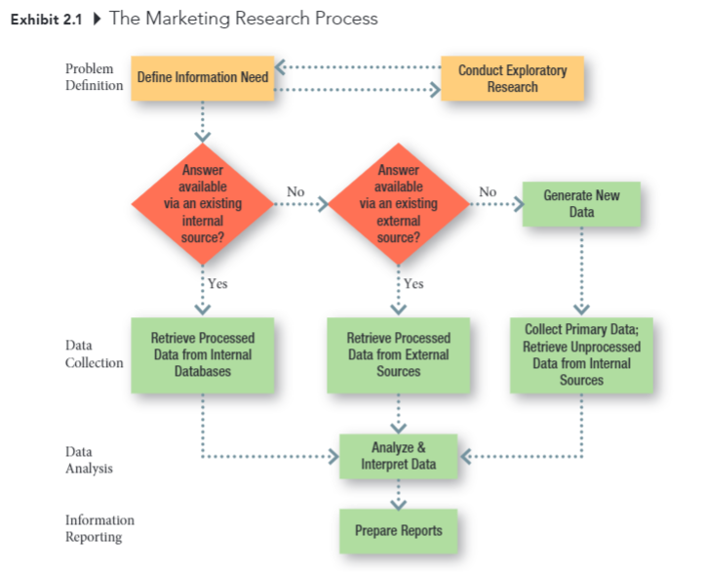
The Marketing Research Proecss
Notes:
Last class we talked about the four phases of a marketing research process which are
Problem definition
Data collection
Data analysis
Information reporting
Throughout this semester, we will cover this diagram in detail.
However, from the problem definition phase to transition to the data collection phase: you usually have to first conduct an exploratory research.
It could a small focus group, or a small pilot study, or just asking experts in the field about the research problem to get to know whether you can define information needed.
Then you have the know whether your internal database, or accessible external database has the data you need.
If not, you have to collect primary data to get to the data analysis phase

Slide 9
Stage One: Problem Definition (Chapters 3 and 4)
What is the purpose of the study?
Is additional background information necessary?
What is the source of the problem?
Is the research discovery – or strategy- oriented?
What information is need to make the decision?
How much is already known?
Can a hypothesis be formulated?
Notes:
Today, we go over questions that you can ask yourself when you conduct your semester project.
These questions can help you formulate a better understanding of your own research.
You can always go back to these questions later on.
To find out what type of information is needed in the problem definition step.
It’s helpful to answer these questions.
And we will go into them in detail in chapters 3 and 4.
I will not read this page to you, but you can review it later.

Slide 10
Stage Two: Data Collection (Chapters 5 to 15)
Can existing data be retrieved form internal sources?
Can existing data be retrieved from external sources?
What is to be measured? How?
What is the source of the data to be collected?
Can observation techniques be used to gather data?
How should observations be taken?
Can objective answer be obtained by asking people?
How should people be questioned?
How should questionnaires be administered?
Should structured or unstructured items be used?
Should the purpose of the study be made known?
What specific behaviors should be recorded?
What criteria define the population? Is a list of population elements available?
Is a probability sample desirable?
How large should the sample be?
Who will gather the data?
How long will the data gathering take?
Notes:
Some key questions in the second stage are as follow. We will go into detail in chapters 5 to 15
More specifically, From chapters 5 through 7, we will look at existing data (could be internal or external).
And chapters 8 through 15, we will look at primary data

Slide 11

Data Sources
Existing data from internal sources
Existing data from external sources
New data from individuals or unprocessed data from internal sources
Notes:
As I mention above, there are typically 3 types of data sources:
Existing data from internal sources
Existing data form external sources, which usually mean you have to purchase to have access to. Or if you are lucky enough, or if you are an academic, companies might you give you access
And lastly, the primary data that you have to use your companies' resources to collect.

Slide 12
General Approaches to Marketing Research
The collection of data to address specific problems
The development of decision support system that provide marketing intelligence on an ongoing basis
Notes:
There are two general approaches to marketing research
Collecting data on specific problems is like a flashlight while collecting ongoing data is like a candle.
Hence, the flashlight approach typically matches new external data sources, while the candle approach typically matches existing internal data.
The Project Approach (Flashlight)
Collecting data to address specific problems,
The Systems Approach (Candle)
Putting systems in place to provide marketing intelligence on an ongoing basis

Slide 13
Stage Three: Data Analysis (Chapters 16 to 18)
Who will handle the editing of the data?
How will the data be coded?
What analysis techniques will be used?
Notes:
Next, in stage three: Data analysis. It will be covered from chapters 16 to 18

Slide 14
Stage Four: Information Reporting (Chapters 19 and 20)
Who will read the report?
What is their technical level of sophistication?
What is their involvement with the project?
Are managerial recommendations called for?
What will be the format of the written report?
Is an oral report necessary?
How should the oral report be structured?
Notes:
Lastly, chapters 19 and 20 will cover information reporting in detail

Slide 15
Marketing Research Ethics
Three Methods of Ethical Reasoning
Utility Approach
Justice Approach
Rights Approach
Notes:
Before going into chapter 3: problem formulation, we will talk a little bit about marketing research ethics. There are three methods of ethical reasoning which are utility approach, justice approach, and rights approach.

Slide 16

Utility Approach
Notes:
The first approach is the Utility approach:, which focuses on society and the net consequences that an action may have. If the net result of benefits minus costs is positive, the act is considered ethical
This approach is also known as “The Ends Justify The Means”.

Slide 17

Justice Approach
Notes:
The second approach is the justice Approach, which focuses on the degree to which benefits and costs are fairly distributed across individuals and groups. If the benefits and costs of a proposed action are fairly distributed, an action is considered to be ethical.

Slide 18

Rights Approach
Notes:
And lastly, the rights Approach, which focuses on the welfare of the individual and that uses means, intentions, and features of an act itself in judging its ethicality.
In other words, If any individual's rights are violated, the act is considered unethical. Hence, this approach can be considered a direct opposition of the utility approach.

Slide 19

Facebook’s Scandal
Notes:
Thinking of the three approaches, we will discuss the Facebook’s scandal with Cambridge Analytica,
Does anyone know this scandal?
And can someone recap the scandal for the rest of the class?
In 2014, approximately 270,000 people used a Facebook app to take a personality test for academic research purposes. Because of Facebook’s terms of service and its application programming interface (API) at the time, however, the app’s developer, Aleksandr Kogan, was also allowed to collect information about users’ Facebook friends (a function it shut down in 2015). Ultimately, Kogan obtained data from up to 87 million users, which he then handed to political consulting firm Cambridge Analytica, which in turn used it to build profiles of individual voters and their political preferences to best target advertising and sway voter sentiment. According to Cambridge Analytica whistleblower Christopher Wylie, the firm used this data to help Donald Trump’s campaign predict and influence voters in the 2016 presidential election.
So can you apply any of the three ethical reasonings to discuss this case study?
Is it okay to sell data since Facebook is free?
Is it okay for a marketing agency to knowingly leverage insider data like this? Was the whistleblower in the right in this case?

Slide 20
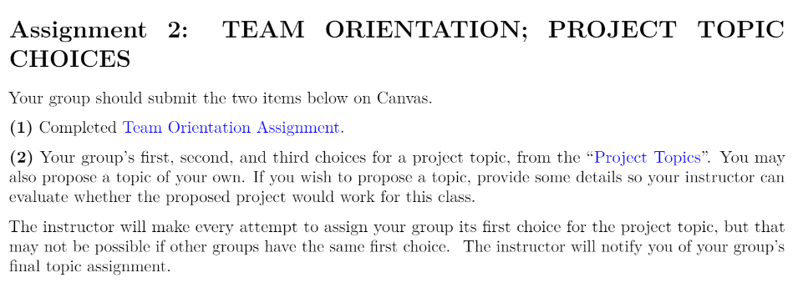
PA #2: Possible Topics
Notes:
Before going into chapter 3, I will go over PA #2 and possible topics. Later, the last 15 mins of the class can be used for your group discussion. But the assignment is not due until the end next Monday, but I strongly urge y’all to talk about it and you can also submit it before Monday if you wish

Slide 21
Chapter 3: Problem Formulation

Slide 22
Problem Formulation
Step 1
Meet with Client
Step 2
Clarify Problem/ Opportunity
Step 3
State Manager’s Decisions Problem
Step 4
Develop Full Range of Possible Research Problems
Step 5
Select Research Problem(s)
Step 6
Prepare Research Request Agreement
Notes:
In Chapter 3 to formulate your problem, you first have to meet with your client, then clarify problem and opportunity available
Then, you have to restate the mangers’ decision problem again before developing full range of possible research problems.
Then you can let the clients select research problem based on their priority.
Lastly, you will have to prepare research request agreement with a formal client. But in this project, you don’t have to do it.

Slide 23

Step 1: Meet with Client
What is the problem or opportunity you’re facing?
What caused you to notice the problem
Why do you think this situation has occurred?
What is likely to happen if nothing changes in the next 12 months?
Is it likely to be an ongoing problem?
What do you hope to accomplish using marketing research?
What actions ill you take depending upon the answer?
Why?
Notes:
You can use the following questions to probe into the problems versus opportunities your clients face for groups that will have an actual business client. The rest of you who choose one of the first seven topics can answer these questions pretending to be the party of interest.
For example, if you have the second topic, you can pretend to be a shop owner in downtown Columbia to answer these questions.

Slide 24
Questions to Establish the Need for Marketing Research
Is there a real need for marketing research?
Research takes time and costs money
Value of information versus the cost of obtaining it
Marketing research is not always needed! Because we might be able to access the info we need cheaper and faster
Notes:
When you meet up with your client, you have to decide whether it is necessary to do a marketing research project.
Questions you can ask is that is there a real need for marketing research?
Because research can take time and money, and you also have to make tradeoff between value of information and the cost of obtaining it.
Hence, marketing is not always needed. Because we might be able to access the information, we need cheaper and faster.

Slide 25
When is Marketing Research NOT needed?
The information is already available
The timing is wrong to conduct marketing research
Funds are not available for marketing research
Costs outweigh the value of marketing research
Notes:
Or your question is not even a marketing research question in the first place.
Hence, you need to be careful and decide whether your marketing research question is answerable.

Slide 26
Sources of Problems/ Opportunities
Unplanned changes
What has happened? (discovery)
Why has it happened? (discovery)
What should we do about the problem or opportunity? (strategy)
E.g., customers’ complaints about menu
Planned changes
What can happen (discovery)
Why could it happen (discovery) How should we implement the change? (strategy)
E.g., seasonal offerings.
Notes:
There are 2 basic sources of marketing problems:
unplanned changes in the marketing environment and
planned changes in environment, serendipity
You can see from the example that unplanned changes are customer’s’ complaints about menu
Or seasonal offering in the case of planned changes.

Slide 27

Step 2: Clarify the Problem/ Opportunity
Reiterate the problem with your clients
Make sure your understanding of the problems match that of your clients
Notes:
One of the most important thing that a research provides a client is a set of “new eyes”
Formulating the true problem or opportunity is often difficult unless you can break away from “Normal” thinking and question assumptions

Slide 28
Define the Problem
Problems are situations calling for managers to make choices among alternatives
Properly defining the problem is the most important step in the marketing research process
Managers make decisions because they have a problem. With the right information, managers can choose the correct decision alternative

Slide 29
Is this a problem?
We are losing money
Market share has decreased
No! This is NOT a problem … it is a symptom
Managers must be careful to avoid confusing symptoms with problems
Notes:
Problem is the why and what to do
As I mentioned above, deceased market share is not a problem, but a symptom. You as a researcher need to help mangers to avoid confusing symptoms with problems.
An analogy is that Covid’s symptoms are fever, chills, cough, fatigue, or loss or taste or smell
But the cause or problem in this case is Covid virus

Slide 30
The Role of Symptoms in Problem Recognition
Symptoms are changes in the level of some key metrics that measures the achievement of an objective (e.g., return on investment, profitability)
Notes:
It is easy to recognize symptoms assuming you have a monitoring system in place.

Slide 31
Sources of Problems
A problem exists when a gap exists between what was supposed to happen and what did happen (i.e., failure to meet an objective)
An opportunity occurs when there is a gap between what did happen and what could happen (i.e., opportunity)
Notes:
There are two sources of problems:
The first one is the gap between that was supposed to happen and what did happen
The second is opportunity when there is a gap between what did happen and what could happen

Slide 32
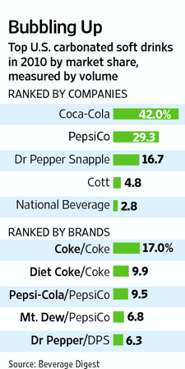
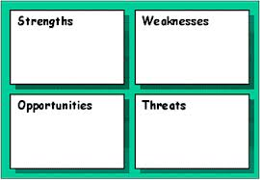
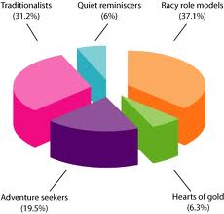
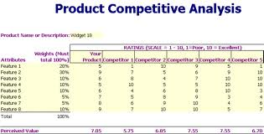
Identify Marketing Opportunities and Problems
Market Demand determination
SWOT Analysis
Competitive Analysis
Market segment identification
Notes:
Some marketing research studies are designed to find out what consumers’ problems are and to assess the suitability of different proposed methods of resolving those problems
Mangers are likely to know the symptoms (e.g., sales are down, market share is falling), but determining the cause of the symptoms sometimes requires research
For example,
Sales are down, but why? What causes it

Slide 33
Problems and Symptoms
iClicker: which one is an opportunity?
A: Sales volume below quota
C: Surveys suggest people moving towards “vegan” options
D: Return on investment is below expectation
Notes:
Which one is symptoms vs. cause (- problem/ potential reason of the symptoms)?

Slide 34
Step 3: State the Manger’s Decision Problem
Discovery-oriented decision problem
Generating useful information (What or Why?)
Strategy-oriented decision problem
Selecting alternative courses of action (How?)
Notes:
The definition of Decision problem is that the problem facing the decision maker for which the research is intended to provide answer:
A well-stated decision problem:
Takes the manger’s perspective
Is as simple as possible
Is stated in the form of a question
There are two orientations to formulating decision problems:
Discovery-oriented decision problem seeks to answer what or why questions about a problem/ opportunity. The focus is generally on generating useful information.
Strategy-oriented decision problem seeks to answer how questions about a problem/ opportunity. The focus is generally on selecting alternative courses of action

Slide 35
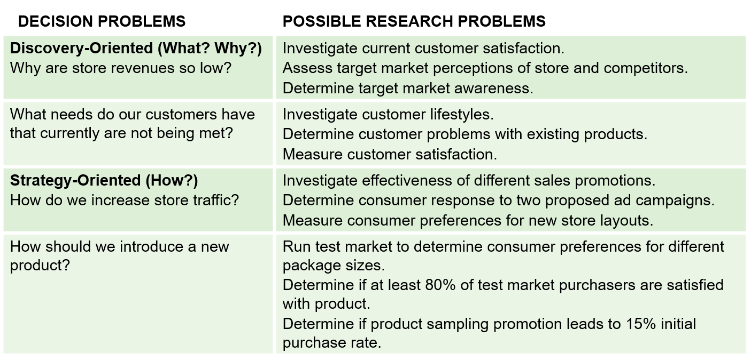
Differences between Decision Problems & Research Problems
Notes:
You can find differences between decision problem and research problem on this slide
Decision problems are those posted by managers
And research problems are those that marketing researchers try to answer
For example,
Resource from Cengage Slide Chapter 3

Slide 36

Step 4: Develop possible Research Problems
Definition: A restatement of the decision problem in research terms.
Investigate current customer satisfaction
Assess Target market perceptions
Determine target market awareness
Notes:
In step 4 of the Problem formulation process, you have to list out all the possible research problems
There will often be MANY research problems associated with a single manager’s decision problem.

Slide 37
Step 5: Select the Research Problem(s) to be Addressed
Trade-off: Value of the information vs. the costs of obtaining it
Notes:
Researchers normally can’t do everything. It is better to address one or two research problems entirely than to try to do many things at once
There is always be a trade-off: value of the information be obtained vs. the costs of obtaining it
In a company, you cannot address every problem at the same time. Hence, you typically have to prioritize and decide on which one to focus on.
Similarly, in a semester, you can only achieve so much. Hence, you have to select research problems that you can address in this timeframe.

Slide 38
Research Objectives
Research objectives are dependent on the “problem” but they are different in that they tell the researcher what he/she must do
Research objectives stated specifically what information will be collected in order allow the manager to select the correct decision alternative
Notes:
doctors vs. mkters: from the judgement of an expert vs. judgement of the consumers / crowd.

Slide 39

Managerial vs. Research Objective
Managerial objective: What the client hope will result from the project (i.e., decisions to be made and outcome to be achieved?)
Research objective: What information will help the client to achieve the managerial objectives
Notes:
To select the right research problems to be addressed. Researchers will have to state their research objectives first.
And in order to state a research objective, it’s important to revisit the managerial objective
For example:
Managerial objective: to develop a more effective advertising campaign
Research objective: to determine which media college students are exposed to most frequently, and which media most strongly influence their purchase behaviors

Slide 40
Management Decision Problem Vs. Marketing Research Problem
Management Decision Problem | Marketing Research Problem
Should a new product be introduced? | To determine consumer preferences and purchase intentions for the proposed new product
Should the advertising campaign be changed? | To determine the effectiveness of the current advertising campaign
Should the price of the brand be increased? | To determine the price elasticity of demand and the impact on sales and profits of various levels of price changes.

Slide 41
Practice Question
Managerial objective: Increase the number of new customers by adding a new deck for outside dining
Research objective: Identify what features customers desire for the deck
Notes:
So this is another practice question.

Slide 42
Practice Question
Managerial objective: increase freshmen’s satisfaction with Mizzou orientation procedures.
Research objective:
Notes:
Remember:
Managerial objective: What the client hope will result from the project (i.e., decisions to be made and outcome to be achieved?)
Research objective: What information will help the client to achieve the managerial objectives
Example:
Identity the current levels of freshmen’s satisfaction with Mizzou orientation procedures.

Slide 43

Practice – iClicker Question
Managerial Objective: Increase number of repeat customers
Research Objective:
Determine current satisfaction and ways to improve it
Determine current levels of brand awareness
Determine the profile of current loyal customers
Both A and C
A, B, and C are correct
Notes:
Research objectives: determine current satisfaction and way to improve it.

Slide 44
Research Questions
Questions that managers want to answer
Determine which media is more effective on target audience:
Which social network platform is more effective at reaching 18–25-year-olds in Columbia?
Which social network platform is more effective in driving purchase decision for 18-25 years olds in Columbia?
Determine customer satisfaction and ways to improve it
Overall, how satisfied are customers with the focal store?
How satisfied are the customers with the speed of delivery?
What customers care about the most when they visit our store?
Notes:
Drill further down to
Define customer before 18-25 yr. RO.
Current, if then, why,
Explore first then descriptive
Ads: content, media, audience

Slide 45

Step 6: Prepare Research Request Agreement
Research request agreement: A document prepared by the researcher after meeting with the decision-maker that summarizes the problem and the information that is needed to address it
Notes:
Step 6 is to prepare research request agreement.
This agreement is a document prepared by the researcher after meeting with the decision-maker that summarizes the problem and the information that is needed to address it
The purpose of the research request agreement is to make sure that everyone understands the problem to be addressed and what the research tries to accomplish
This step is not necessary for the project since this is s a student project.

Slide 46
Sections of a Research Request Agreement
Background
Decision problem
Research problem(s)
Use
Population and subgroups
Logistics
Notes:
This slide is for your reference if you want to know what sections should be in a research request agreement.

Slide 47
Research Proposal
Research Proposal: A written statement that describes the marketing problem, the purpose of the study, and a detailed outline of the research methodology
The research proposal differs from the research request agreement because it includes the proposed research method and is much more detailed
Notes:
In this class, your research topic is to be selected, so you don’t need to make a research proposal, but you can still view it on this slide.

Slide 48
Research Proposal Outline
A. Problem Definition and Background
B. Research Design and Data Sources
C. Sampling Plan
D. Data Collection Forms
E. Analysis
F. Time Schedule
G. Personnel Requirements and Cost Estimate
H. Appendices

Slide 49
Up next
PA #1 is due by the end of today
Quiz 2 is due by Sunday
Chapters 2, and 3
PA #2 due soon
Notes:
I haven’t seen anyone taking the practice quiz yet, Please take the practice quiz before taking the first quiz
Moreover, remember, you cannot use browser to search for answers online,
But you are allowed to use your notes. So please read the textbook, review the class material, and then take the quiz

Slide 50
15-minute group meeting
Team Orientation Assignment
Project Topics
Notes:
Please open and discuss the team orientation assignment and project topics.

Slide 51
5-min Snippet
Wordcloud
Word Frequency
Notes:
Using your answers, we can perform some exploratory analysis to get insights from this blob of texts.
R-script:
What is your name? State your name and where you are from
What is your quest? What year are you (e.g., junior, senior)? What would you like to do at the end of your program (e.g., sales agent, marketing consultant, etc.)?
What is your favorite color? Tell an interesting fact, hobby, or experience you have.
What is the airspeed velocity of an unladen swallow? Some questions are just hard! What question would you like to be able to answer at the end of this course? In other words, what would you like to learn about marketing research?

